Slide 1

205SE Programming for Engineers
Tutorial 1 – Version Control System
How to use CU GitHub with Visual Studio 2019
Chris Bass

Slide 2

Today’s Tasks
About Git, GitHub and attempt to login to CU GitHub.
Create a new remote repository for completing the weekly tutorial tasks.
“<username>-tutorialwork”.
Create new solutions inside the remote repository for each new tutorial task.
“T1-HelloWorld” and “T1-ASCIIArt”.
Complete the tutorial tasks and make your first git commit and git push from Visual Studio.
Create another new remote repository for completing the coursework
“<username>-coursework”.
Clone the CW-STARTING-POINT repository for starting the coursework and change the remote to your own.
Modify the name and SID at the top of the main C++ source file to your own.
Programming games: Lightbot game, Codingame.

Slide 3

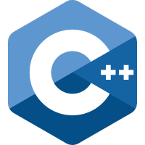
About Git and GitHub
Why Git? – The use of Git version control tools has become an industry standard for managing source code. Useful for coding jobs especially teams
Git is a free and open source distributed version control system it has its own language syntax e.g. git init, git clone, git commit, git push… etc.
GitHub is a Git repository hosting service. GitHub provides a Web-based graphical interface for managing a Git repository.
CU GitHub is a Coventry University hosted GitHub. We will be using CU GitHub for looking after our source code.

Slide 4
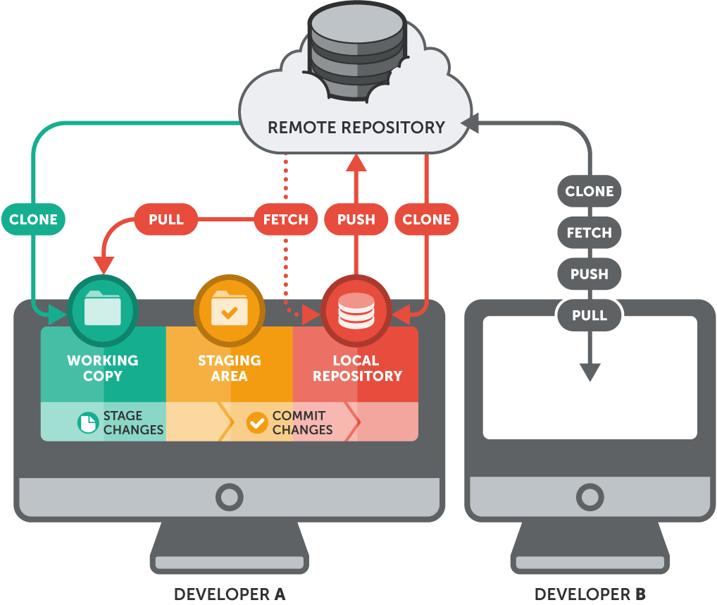
First we will create a remote repository
CU GitHub
Git commands
Then we will create our local repository and link them together

Slide 5
Attempt to login to CU GitHub
Navigate to:
https://github.coventry.ac.uk/205SE-1920SEPJAN
In the top right click ‘Sign in’
Enter your normal University login details
If you cannot login, or cannot access the 205SE class page then I need your University username, so that I can add you

Slide 6

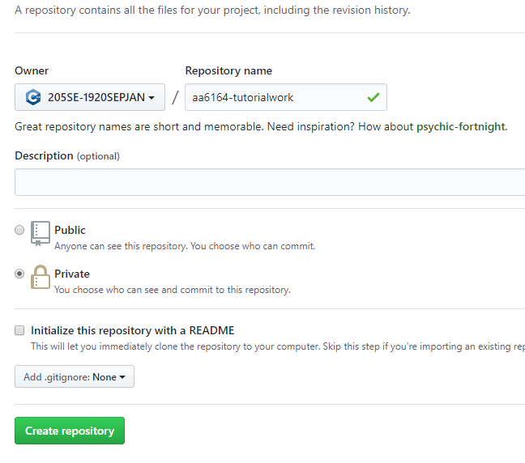
Create a remote repository
Click on the green ‘New’ button
Create a new remote repository under our 205SE class with these settings
Repository name should be ‘<your_username>-tutorialwork’ e.g. aa6164-tutorialwork

Slide 7
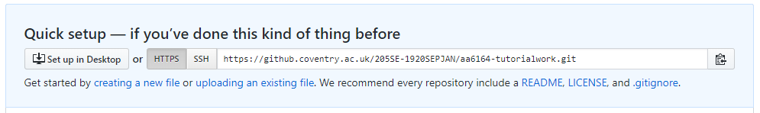
Create a remote repository
We now have an empty remote repository setup for storing our source code
Copy your remote URL for later
Click to copy

Slide 8
Create a local repository
Now we will use the GUI tools in Visual Studio 2019 to setup a local repository and link it to our newly created remote
(Note that this can also be done via the git command line if we wanted to)
Open Visual Studio 2019
Navigate to the Team Explorer pane

Slide 9
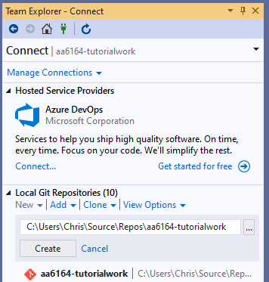
Create a local repository
Under ‘Local Git Repositories’ click ‘New’
Type in a name to match what we named the remote and click create
e.g. ‘aa6164-tutorialwork’
Double-click the newly created local repository

Slide 10

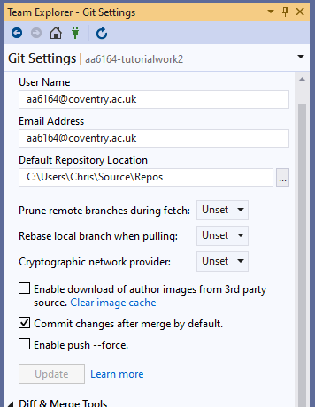
Home → Settings
Under the Team Explorer (local repository, Home) click ‘Settings’
Click ‘Global Settings’
Check your username and email address fields are both set to your University email address e.g. aa6164@coventry.ac.uk
Click ‘Update’ and navigate back to the local repository, Home page

Slide 11

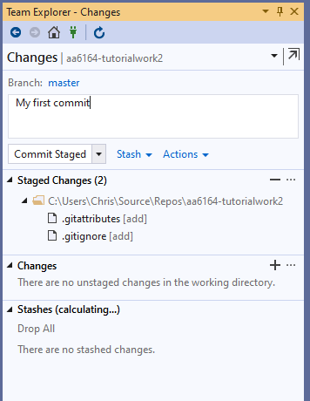
My first git commit
The git commit command is used to save your changes to the local repository
From the local repository, Home page select ‘Changes’
Type in a commit message, for example ‘My first commit’ and click Commit Staged
This will update the local repository with our changes – in this case a .gitattributes and a .gitignore file

Slide 12

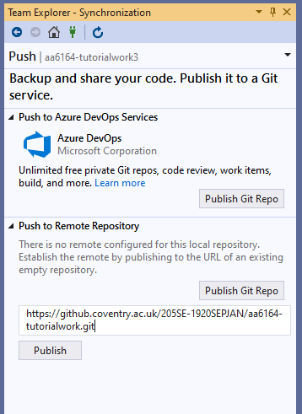
Link the local repository to the remote
Under Team Explorer, local repository, Home click Sync
Under ‘Push to Remote Repository’ click ‘Publish Git Repo’
Paste the remote repositories URL and click ‘Publish’
This will link the two repositories, git init the remote and perform a push of our first commit all-in-one

Slide 13
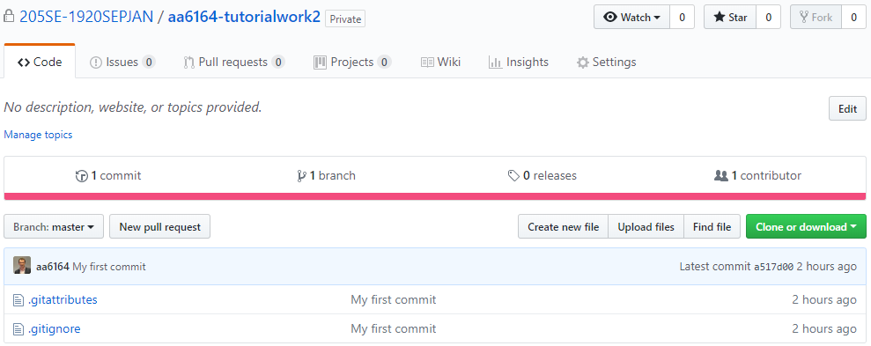
Refresh and inspect the remote
Refresh the web browser on the remote repository
If the git push worked correctly then the remote repository will now have stored changes, in this case a .gitattributes and a .gitignore file

Slide 14
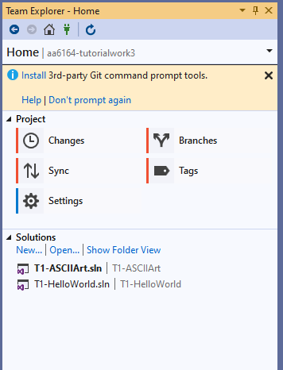
Make a change – adding solutions
Let’s add a couple of Visual Studio Solutions to the local and remote repositories
In Visual Studio under Team Explorer, local repository, Home → Solutions click ‘New’
The normal ‘Create a new project’ window will popup and we want to create a C++ ‘Console App’
Create one solution called ‘T1-HelloWorld’ and repeat the process to create another solution called ‘T1-ASCIIArt’
You can double-click on a solution to switch between them

Slide 15
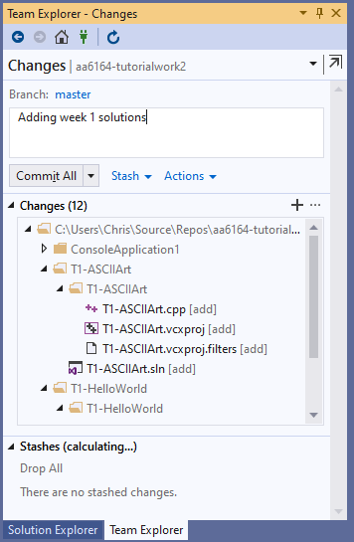
Commit changes
Now we have made some changes we can commit (save) these to our local repository
Home → Changes → add a commit message and click Commit All

Slide 16
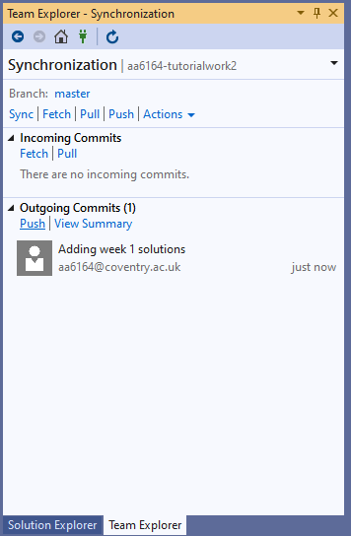
Push local commits to remote
Now we can update our remote repository with the commits we have locally
Home → Sync → Outgoing Commits → Push

Slide 17
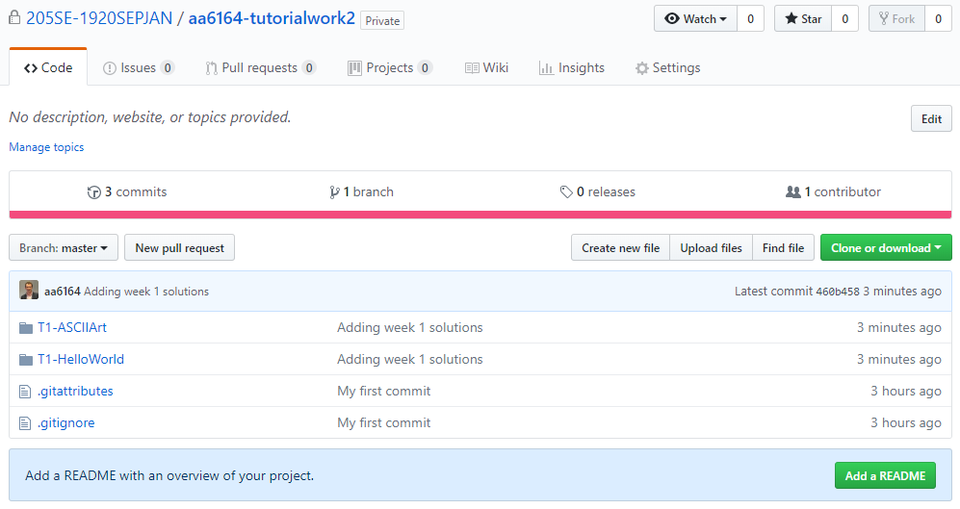
Refresh and inspect the remote

Slide 18
Hello World source code
From Team Explorer → Home → open your T1-HelloWorld solution
Switch tabs to the ‘Solution Explorer’ tab
Note that under the ‘Source Code’ virtual folder a C++ source file has been added with a HelloWorld program, ‘T1-HelloWorld.cpp’. Double-click to open it in the editor.
Let’s ‘Build’ and then ‘Run’ our program to see the console output

Slide 19
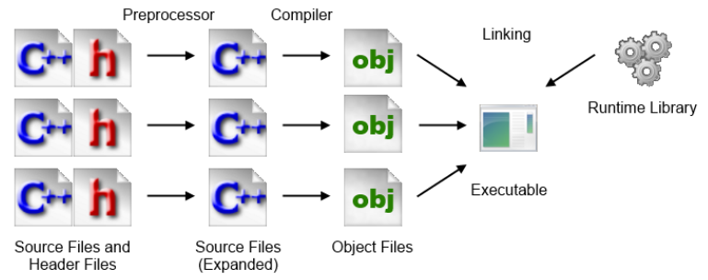
Building C++ code in Visual Studio for Windows
C++ compilation process – see document on Moodle for more details:
Editing source files (.cpp .h)
Building
Preprocessor
creates expanded source files (expanded .cpp)
Compiler (and Assembler)
creates machine code stored in object files (.o or .obj)
Linking
creates executable (.exe for Windows)
Load and Execute

Slide 20

Activity 1 – using cout
cout is the standard output stream object in C++ (in this case the windows console). Using the cout object:
Make a change to the source code so that it will print hello world, then an empty line and then your name on another separate line
Make a change to the source code so that it will print hello world and your name inside separate boxes of star characters i.e.
***************
* Hello World *
***************
* Chris *
***************
Hint:
std::cout << std::endl;
can be used to print a new line.
You can test your output by building and running your code again.
Once you have the correct output, use Team Explorer to commit the changes to the local repository and then push the changes to the remote repository.
Check CU GitHub has your code uploaded correctly, drill down to find source.

Slide 21

Activity 2 – ASCII Art
In Team Explorer, switch to your ‘T1-ASCIIArt’ solution
Search online and find some ASCII art
Can use Moodle link to ASCII text generator
Write a console program to output the ASCII art to the console window!

Slide 22
Examples of ASCII Art:
db .d88b. .d88b 888 888 db w
dPYb YPwww. 8P 8 8 dPYb 8d8b w8ww
dPwwYb d8 8b 8 8 dPwwYb 8P 8
dP Yb `Y88P' `Y88P 888 888 dP Yb 8 Y8P
---------------+---------------
___ /^^[___ _
/|^+----+ |#___________//
( -+ |____| ______-----+/
==_________--'
~_|___|__

Slide 23

Reflection on Activity 2
Did anyone notice that some characters like the backslash did not print out in the console window as expected?
Why do you think that is?
Check out the link on Moodle ‘Escape sequences’
Fix the program for any characters that are not printing correctly
Once you have the correct output, use Team Explorer to commit the changes to the local repository and then push the changes to the remote repository.
Check CU GitHub has your code uploaded correctly, drill down to find source.

Slide 24
Working with an existing GitHub repository
Now what happens when we want to switch PC and carry on working on our existing GitHub repository?
GitHub can be fussy sometimes, in that we must start from the latest version of our source code (stored on the remote), before we are able to push further changes to the remote
When switching to a new PC we need to git clone a GitHub repository before we can work on it (or if we just have an older version, we can pull any changes to update our local repository to match the remote)

Slide 25
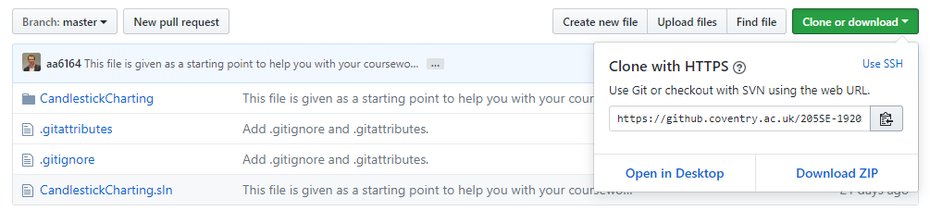
Starting the Coursework
Now I have already created a repository on our CU GitHub page which we can clone and begin working on
Navigate to our CU GitHub page and find the remote:
https://github.coventry.ac.uk/205SE-1920SEPJAN/CW-STARTING-POINT
Click on ‘Clone or download’ and copy the URL

Slide 26
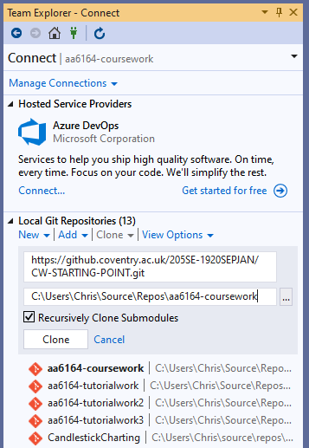
Clone a remote repo
In Team Explorer click manage connections
Under ‘Local Git Repositories’ click the clone dropdown and paste the URL of the remote repo.
Next modify the directory to save under as <username>-coursework e.g. aa6164-coursework
Click the clone button and then double-click the cloned repository to open it

Slide 27
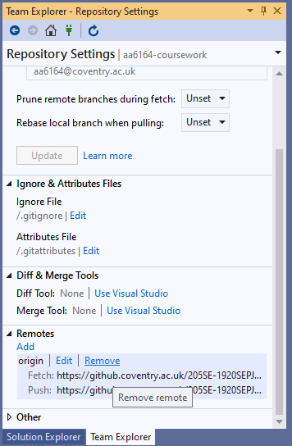
Changing the remote repository
Now for your own repositories you would now normally be able to begin work editing, making commits and pushing in the normal way.
However in this instance I want you to change the remote repository to a remote which you own.
Home → Settings → Repository Settings → Remotes dropdown → Remove the remote

Slide 28
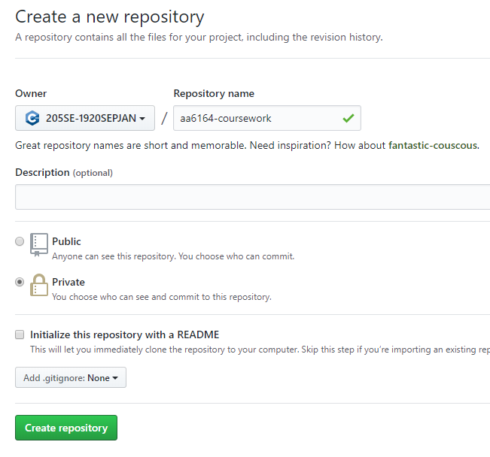
Create a new remote for coursework
On CU GitHub click on the green ‘New’ button
Create a new remote repository under our 205SE class with these settings
Repository name should be ‘<your_username>-coursework’ e.g. aa6164-courseworkwork

Slide 29
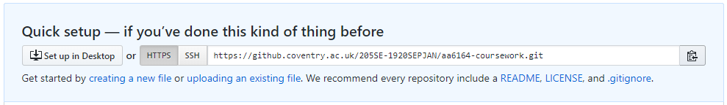
Create a new remote for coursework
We now have an empty remote repository setup for storing our source code for the coursework
Copy your remote URL for later
Click to copy

Slide 30
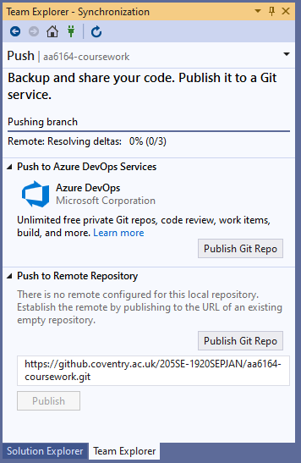
Changing the remote repository
Back in Visual Studio Team Explorer
Home → Sync → Publish Git Repo → paste the URL and click Publish.
So now you should have your own remote with a clone of the starting point for the coursework

Slide 31
View the source code and make a change
Double-click the solution we just cloned
Open the Solution Explorer and find the cloned source file
You can build and run the project if you like
Now the first change to make to the source is to change the author and SID in both the comments at the top and the title in the main()
Once you are happy with the changes, do a commit and a push
Check that your remote now contains your name and SID

Slide 32

Programming Game
Last Activity for this tutorial is a light-hearted programming game to practice your problem solving skills:
Lightbot game:
https://lightbot.com/hour-of-code.html

